Slide 1
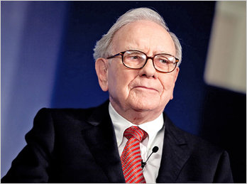
1.Warren Buffett
Sunil Kumar (Financial Advisor and coach ) +919650980704 (Only For WhatsApp massages )
"It's far better to buy a wonderful company at a fair price than a fair company at a wonderful price."
The Warren Buffett strategy is a long term value investing approach passed down from Benjamin Graham’s school of value. Buffett is considered to be one of the greatest investors of all time. His investing strategy, value, and principles can be used to help investors make good investment decisions.

Slide 2
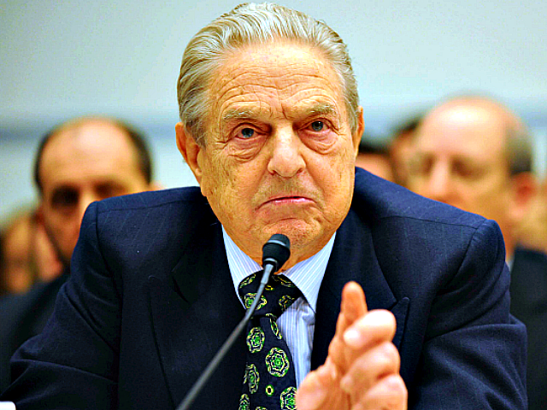
2.George Soros ( Forex Trader )
Sunil Kumar (Financial Advisor and coach ) +919650980704 (Only For WhatsApp massages )
Soros breaks the Bank of England and earns $1 billion in 1 day
2. Soros earns $790 million, crashes the Thai baht and triggers the Asian crisis
3 . Soros gains $1.4 billion from the falling
yen

Slide 3
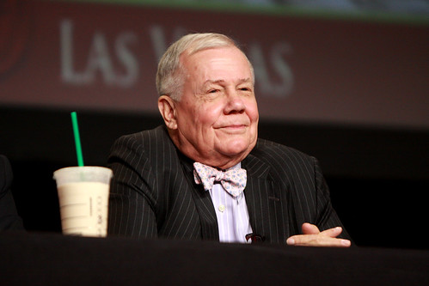
Sunil Kumar (Financial Advisor and coach ) +919650980704 (Only For WhatsApp massages )
3.Jim Rogers ( Commodity Trader )
-- Breaking a Guinness World Record. In November 1991, Jim Rogers (Investment Biker) and his girlfriend Tabitha Estabrook returned from a 2-year Around-the-World journey, riding 57,022 miles and setting a world record for "Longest Motorcycle Ride by a Couple".

Slide 4
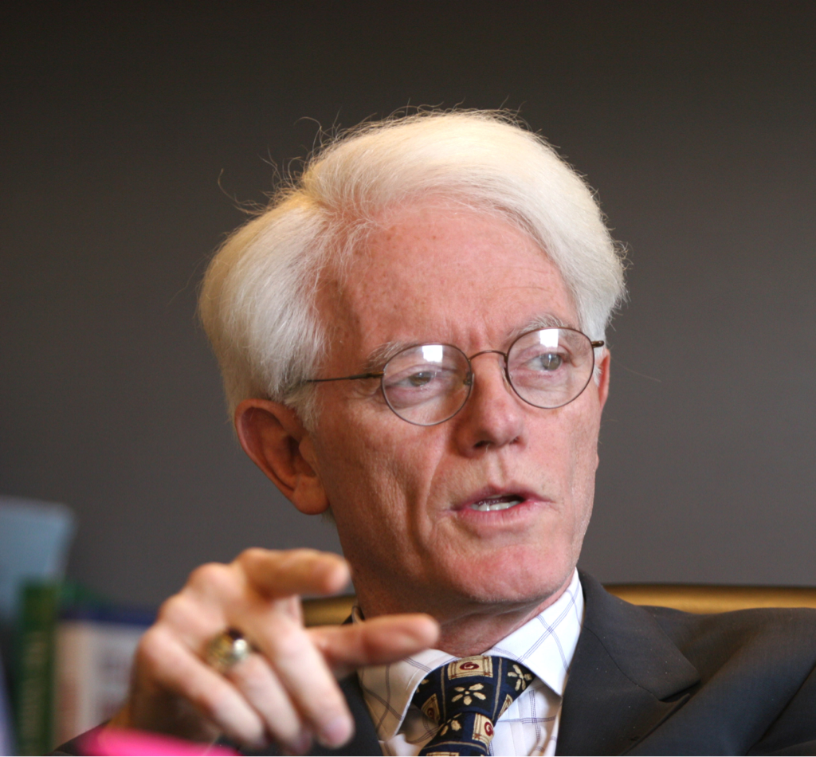
4.Peter Lynch ( Fund Manager )
Sunil Kumar (Financial Advisor and coach ) +919650980704 (Only For WhatsApp massages )
# Peter Lynch is one of the most successful investors in history.
# Lynch managed the legendary Magellan Fund at Fidelity.
# The fund earned an annualized return of 29.2% during his time running it, more than twice what the S&P 500 earned during that time

Slide 5
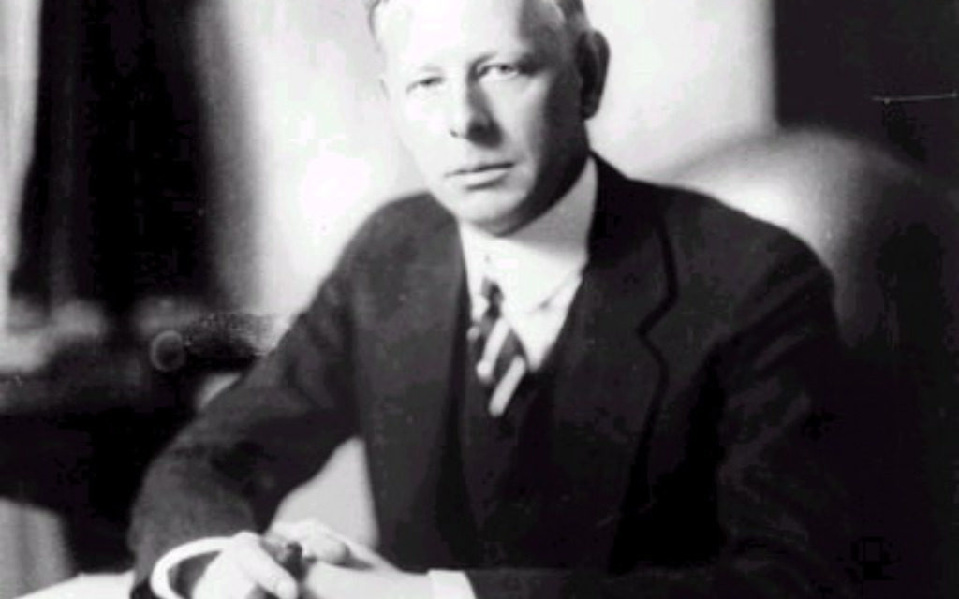
5. Jesse Livermore (Never act on tips )
Sunil Kumar (Financial Advisor and coach ) +919650980704 (Only For WhatsApp massages )
“To invest or speculate successfully, one must form an opinion as to what the next move of importance will be in a given stock.
“Speculation is nothing more than anticipating coming movements.
“In order to anticipate correctly, one must have a definite basis for that anticipation.”

Slide 6
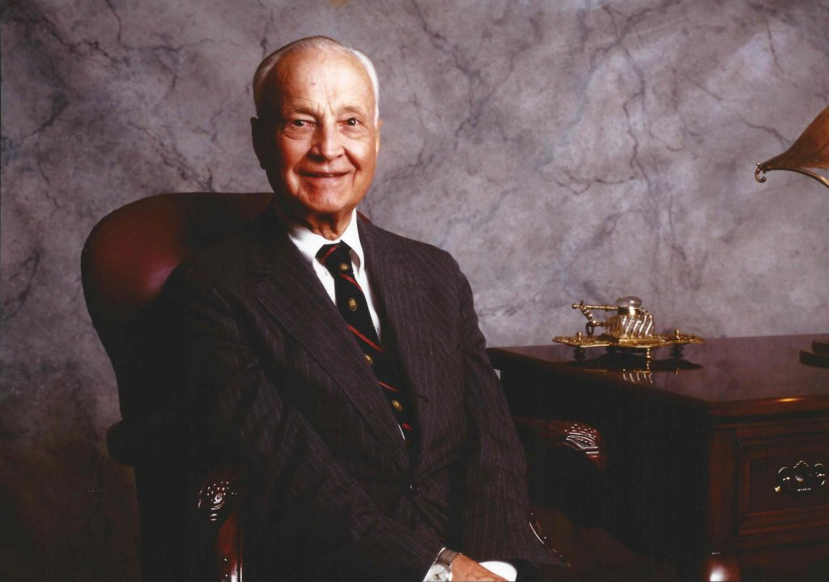
6. Sir John Templeton (Investor and fund manger)
Sunil Kumar (Financial Advisor and coach ) +919650980704 (Only For WhatsApp massages )
“Templeton attributed much of his success to his ability to maintain an elevated mood, avoid anxiety and stay disciplined. Uninterested in consumerism, he drove his own car, never flew first class and lived year-round in the Bahamas..
“"Buy when there's blood in the streets,.”

Slide 7
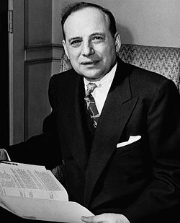
6. Benjamin Graham (Value Investing)
Sunil Kumar (Financial Advisor and coach ) +919650980704 (Only For WhatsApp massages )
The original Benjamin Graham Formula for finding the intrinsic value of a stock was:
V = EPS × (8.5 + 2g)
where:
V = intrinsic value
EPS = trailing 12mth EPS of the company8.5 = P/E ratio of a zero growth stock
g = long term growth rate of the company

Slide 8
6. Benjamin Graham (Value Investing)
Sunil Kumar (Financial Advisor and coach ) +919650980704 (Only For WhatsApp massages )
The original Benjamin Graham Formula for finding the intrinsic value of a stock was:
V = EPS × (8.5 + 2g)
where:
V = intrinsic value
EPS = trailing 12mth EPS of the company8.5 = P/E ratio of a zero growth stock
g = long term growth rate of the company

Slide 14
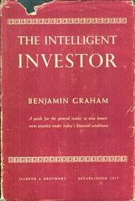
The Intelliegent investor
Sunil Kumar (Financial Advisor and coach ) +919650980704 (Only For WhatsApp massages )
There are 3 principles to intelligent investing:
1. analyze for the long term, protect yourself from losses, and don’t go for crazy profits.
2. Never trust Mr. Market, he can be very irrational in the short and medium term.
3. Stick to a strict formula by which you make all your investments, and you’ll do fine

Slide 16



Life
Childhood experiences that influenced him/her
His/her education
People who influenced him / her
Provide background information about the person you are discussing. Important information could include:

Slide 17
Work
Significant event description
Significant event description
Significant event description
1
2
3
Provide information about the significant events he/she completed.

Slide 18
Influence
Jan. 20YY
Describe your subject’s impact
Feb. 20YY
Describe your subject’s impact
Mar. 20YY
Describe your subject’s impact
Explain to your audience the influence and/or impact he/she had in life.

Slide 19






Awards and recognition
Award description
Award description
Award description
Share the awards and recognition awarded to him/her.
Award description
Award description
Award description

Slide 20







Legacy
Legacy description
Legacy description
Legacy description
Legacy description
Legacy description
Legacy description
Describe for your audience the legacy he/she has left. How has he/she changed the world.

Slide 21

How to use this template
Follow the instructions on each slide to create your presentation.
Remember a PowerPoint is a visual for your presentation. The words on each slide should serve only as talking points (rather than everything you are going to say).
Images and graphics add interest; be sure to add them to your slides when appropriate.
Use the Design Ideas feature to create beautiful presentations.
Go to the Design ribbon and select Design Ideas.
Choose Transitions and Animations carefully. (You want your audience to focus on your content, rather than your effects.)

Slide 22
Customize this Template
Template Editing Instructions and Feedback

